Slide 1
Summer Training Presentation On ATM MACHINE
Submitted to: Submitted By:
Mr. Sudhakar Kumar Priyadarshini
Roll no. LCO17373

Slide 2
introduction
An automated teller machine (ATM) is an electronic telecommunications device that enables customers of financial institutions to perform financial transactions.
It is an electronic device which is used by only bank customers to process account transactions.
The users access their account through special type of plastic card that is encoded with user information on a magnetic strip.
The strip contains an identification code that is transmitted to the bank’s central computer by modem.
The users insert the card into ATMs to access the account and process their account transactions. The automated teller machine was invented by john shepherd-Barron in year of 1960

Slide 3
Software and hardware requirements
Software Requirements:
Windows 8.1
Python ( Jupyter Notebook)
Wamp Server
Hardware Components:
Processor
Hard Disk
Memory

Slide 4
Flowchart:
System
Startup
Operator
System
Shutdown
customer
Session
Invalid PIN
Bank
Transaction
Withdrawal
Deposit
Transfer
Inquiry

Slide 5
About language
PYTHON It is a widely used general-purpose, high level programming language. It was initially designed by Guido van Rossum in 1991 and developed by Python Software Foundation.
It was mainly developed for emphasis on code readability, and its syntax allows programmers to express concepts in fewer lines of code.
Features:-
1) Easy to Learn and Use.
2) Expressive Language.
3) Interpreted Language.
4) Cross-platform Language.
5) Free and Open Source.
6) Object-Oriented Language.
7) Extensible.
8) Large Standard Library.
9) GUI Programming Support.
10) Integrated.

Slide 6
SQL
It is a database computer language designed for the retrieval and management of data in a relational database.
SQL stands for Structured Query Language. This tutorial will give you a quick start to SQL. It covers most of the topics required for a basic understanding of SQL and to get a feel of how it works
SQL is Structured Query Language, which is a computer language for storing, manipulating and retrieving data stored in a relational database.
High Speed
Well Defined Standards Exist
No Coding Required

Slide 7
Server
WampServer is a Windows web development environment. It allows you to create web applications with Apache, PHP and the MySQL database. It also comes with PHPMyAdmin to easily manage your databases.
Wamp stands for Windows/Apache/MySQL/PHP, Python, (and/or) PERL
The acronym WAMP refers to a set of free (open source) applications, combined with Microsoft Windows, which are commonly used in Web server environments. The WAMP stack provides developers with the four key elements of a Web server: an operating system, database, Web server and Web scripting software

Slide 8
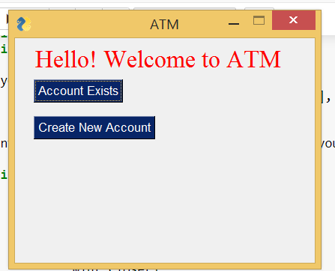
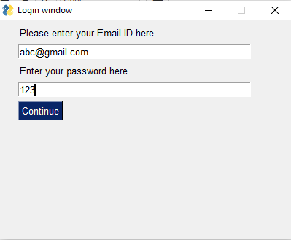
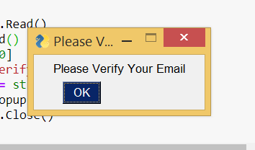
Welcome Window
Login Window
Verifying the Email

Slide 9
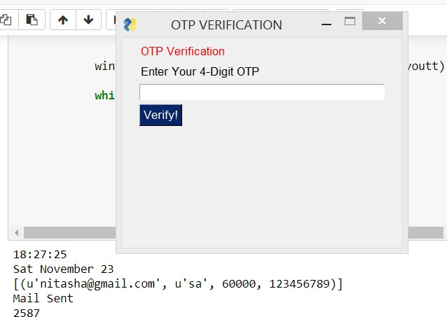
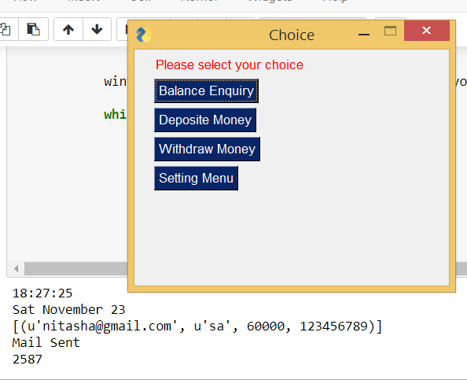
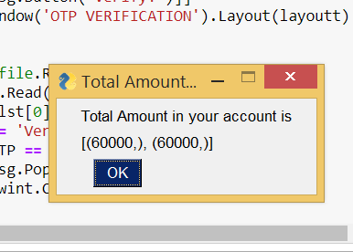
OTP Verification
Choices
Balance Enquiry

Slide 10


